Slide 1
Mavericks’ Elo History
Xavier Epps, Joshua Simons, and Teddy West

Slide 2
Introduction and Dataset
Elo Rating is a way to quantitatively measure the performance of NBA teams relative to their competition.
Elo ratings first saw use in chess to assess the relative skill of given competitors, and it is used in the same manner for NBA teams.
The original github dataset goes back to 1946. We restricted this dataset to 1981 when the three point line was introduced as the game has not drastically changed since then.
Our dataset contains 84,572 NBA games from 1981-2015 with 22 variables, including the Elo ratings of each team both before and after each game. To further restrict this dataset, we focused on the Dallas Mavericks from 1981-2015 which gave a total of 3013 NBA games to analyze.

Slide 3
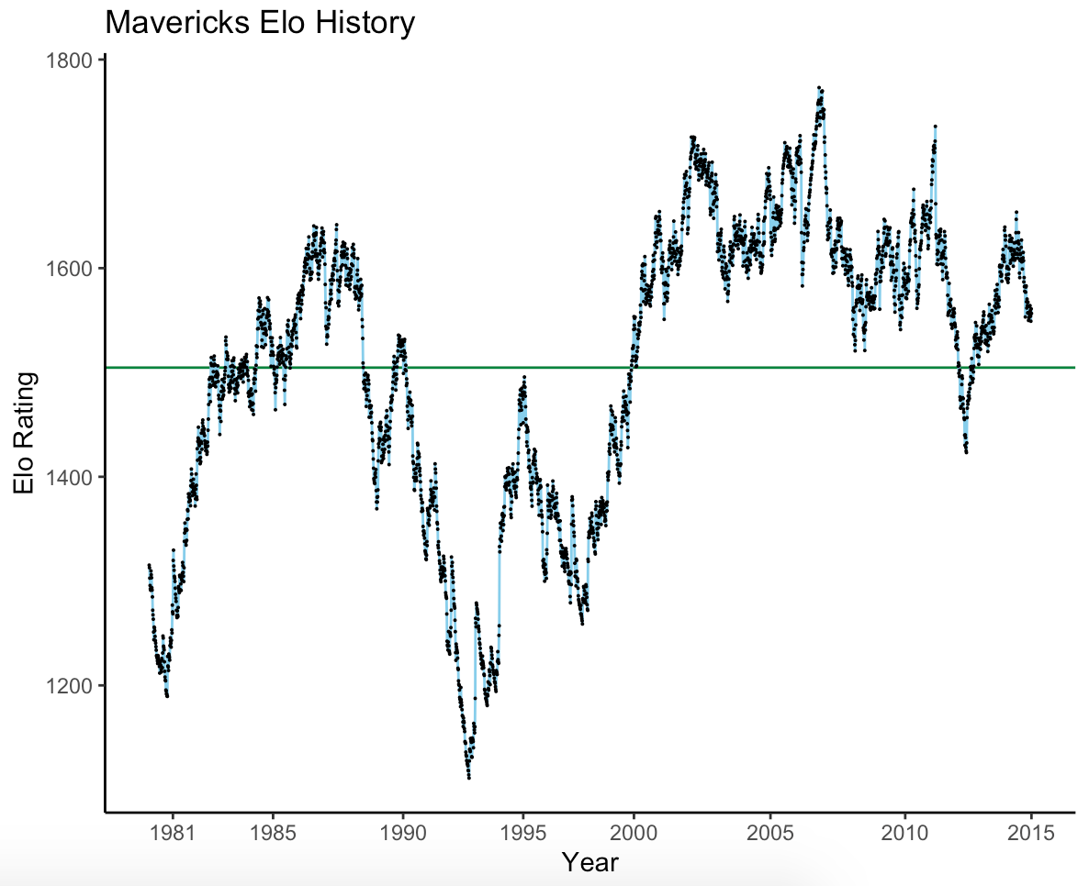

Total Mean Elo Rating = 1496.53
Highest Elo Rating (03/11/2007) = 1773.13
Lowest Elo Rating (03/15/1993) = 1111.10
Lowest Yearly Mean Elo (1993) = 1187.30
Highest Yearly Mean Elo (2007) = 1695.09
Championship Year Mean Elo (2011) = 1635.18
Highest average Elo doesn’t coincide with the Championship Season
Mean

Slide 4
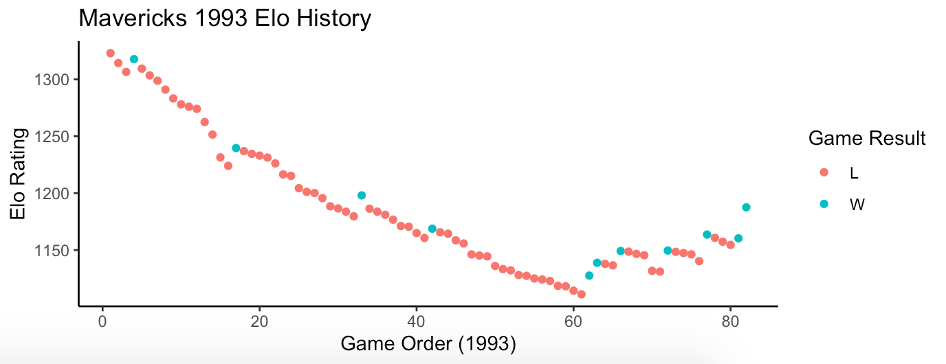
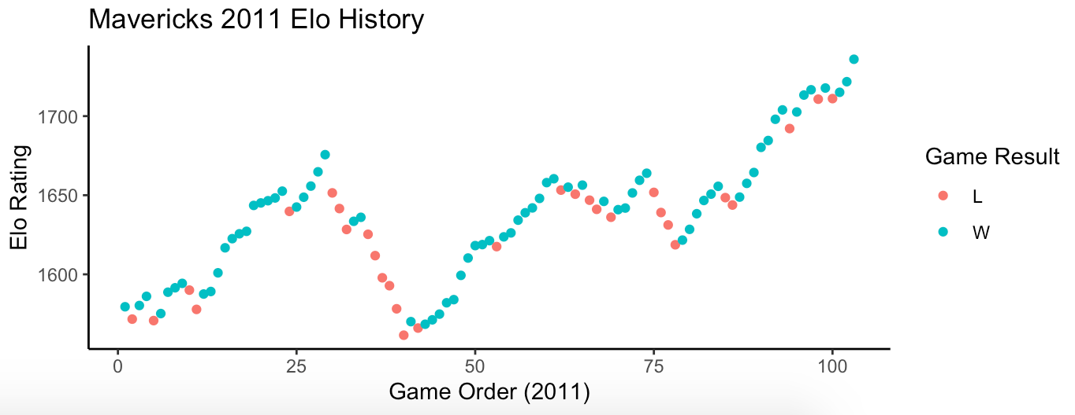
Worst Year (1993):
Elo ratings fall with every loss and rise with every win
Best Year (2011):
Notice the difference in the y-axis and the win streak once the playoffs commence (>game 82)

Slide 5
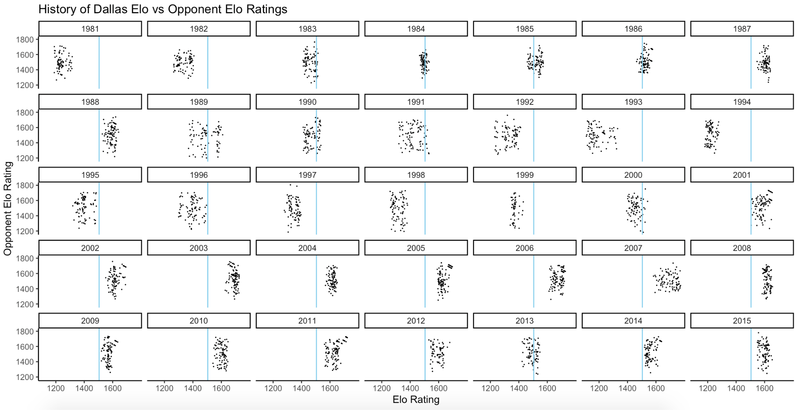
Historical Mavericks Mean Elo as vertical line for all of the Mavericks’ individual seasons
The horizontal spread of the data tends to be much lower than the vertical spread
Years with notably high variance for the Mavericks are 1989, 1991-1993, and 1995-1996

Slide 6
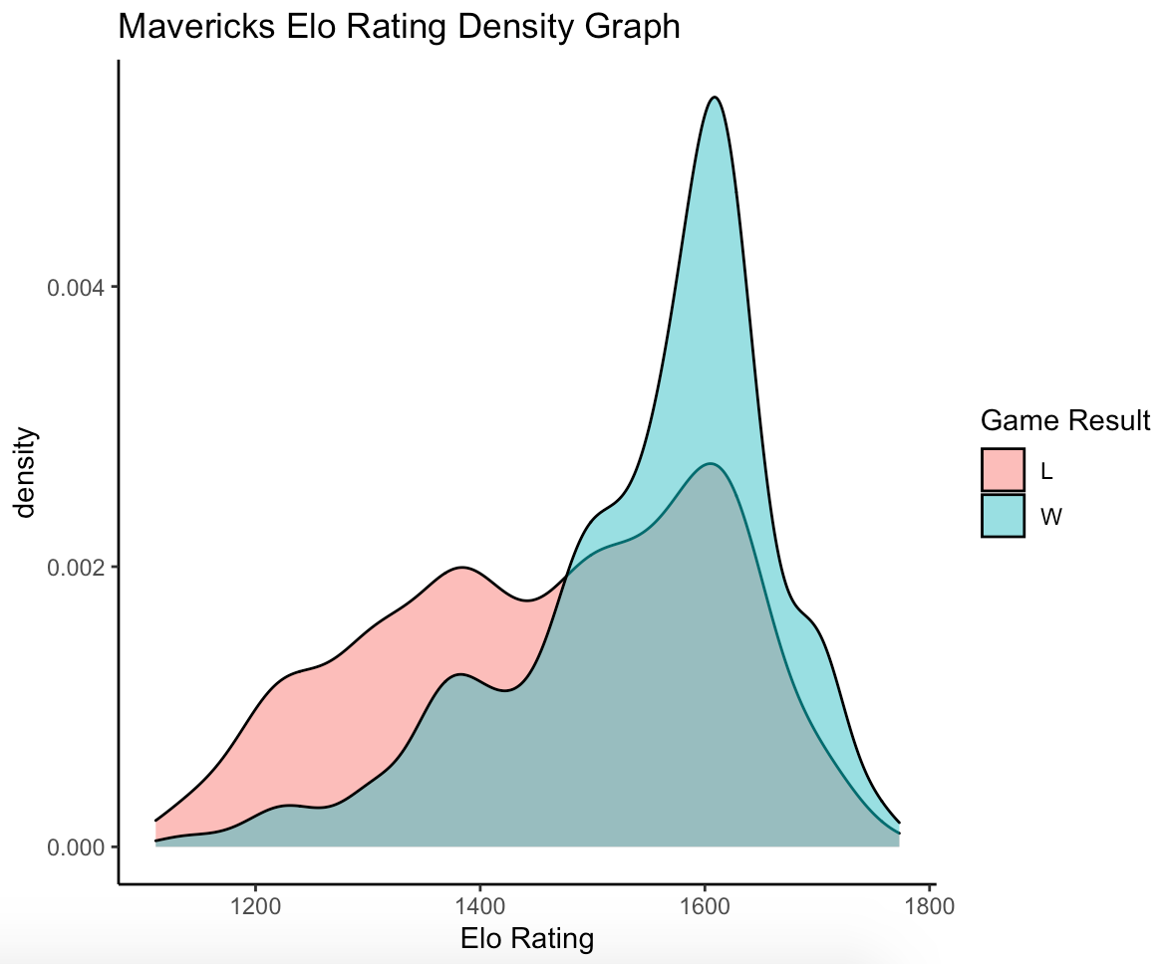
Large increase in Density seen around the Elo rating 1600
Small spike in Density around the Elo rating 1400
Intersection of Wins and Losses around Elo Rating 1500 as expected

Slide 7
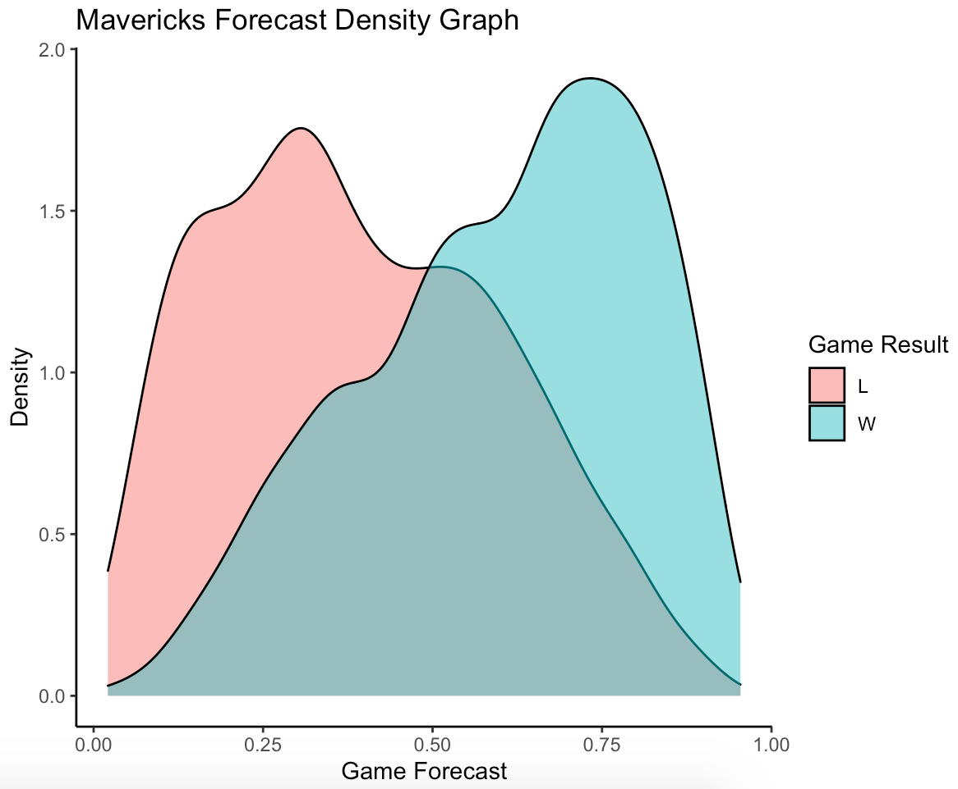
Game Forecast is a probability of winning that is given to each team
While a Forecast of 1.00 theoretically means a 100% chance of winning, this can never be the case so teams are never given this value
High Forecast associated with more Wins as expected
Skewed distributions with some interesting steps in the range from 0.25 - 0.75 for Wins, and from 0.10 0.60 for Losses
Equal Density at 0.50 as expected

Slide 8
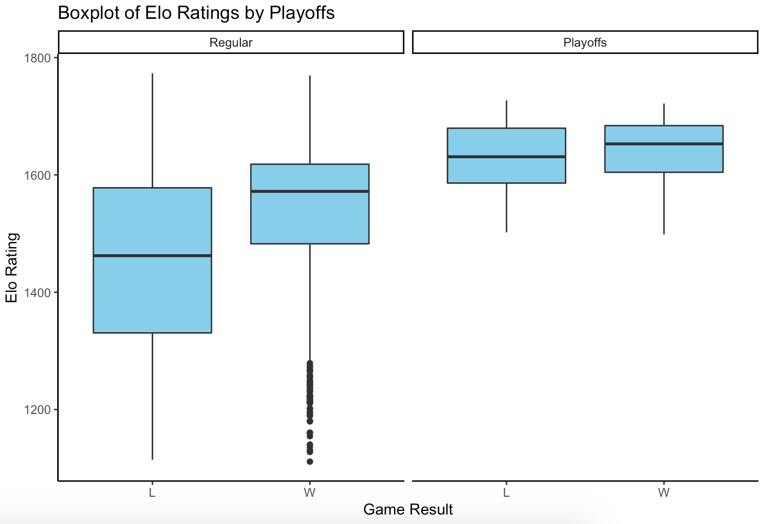
Notably Higher median Elo rating for Regular season Wins
Very similar median Elo ratings for Playoff games, but a slightly higher median Elo rating for Wins
Much lower Variance of Elo Ratings in Playoff games

Slide 9
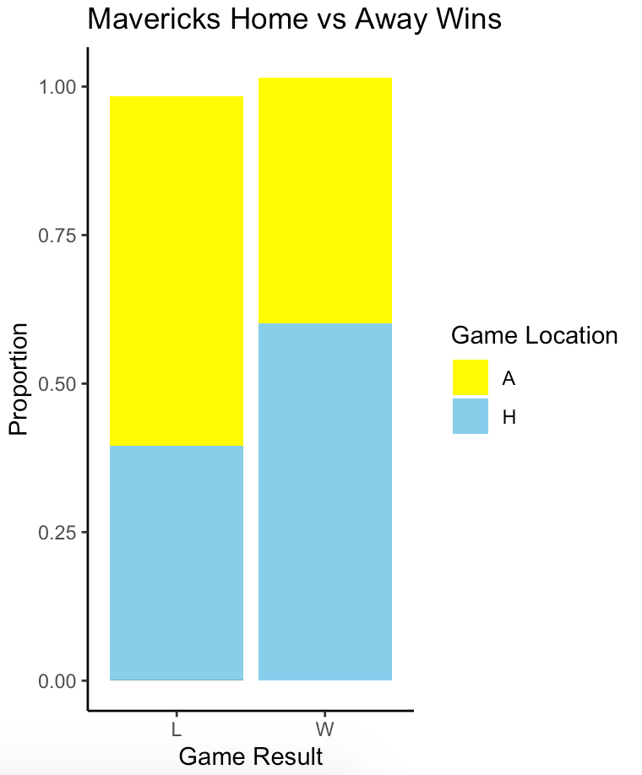
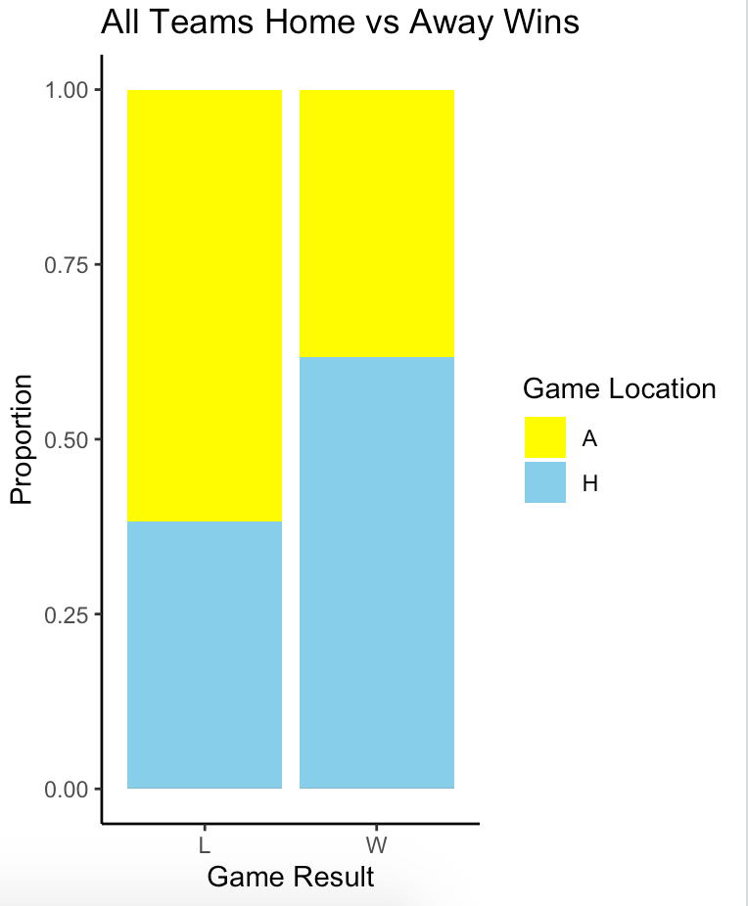
Dallas Home Win Proportion = 0.6038
Dallas Away Win Proportion = 0.4126
Total Home Win
Proportion = 0.6179
Total Away Win
Proportion = 0.3821

Slide 10
Future Work
Trace the changes in rules and play-style within the NBA as they relate to Elo scores.
Extend these graphics to other teams in the NBA and note similarities and differences.
Ex: Are there teams with notably higher home court advantages?
Has the variance between Elo averages of teams changed throughout the history of the NBA?

Slide 11
References
Dmil. fivethirtyeight. (2018), Historical NBA Elo Ratings [Elo data from all NBA teams] Retrieved from: https://github.com/fivethirtyeight/data/tree/master/nba-elo
Thank You For Listening!

